Slide 1
Nordic Innovation We connect people, businesses and organizations for a sustainable future

Slide 2
The Nordic Region - home to 27 million
Greenland
Sweden
Iceland
Finland
Norway
Faroe Islands
Åland Islands
Denmark

Slide 3
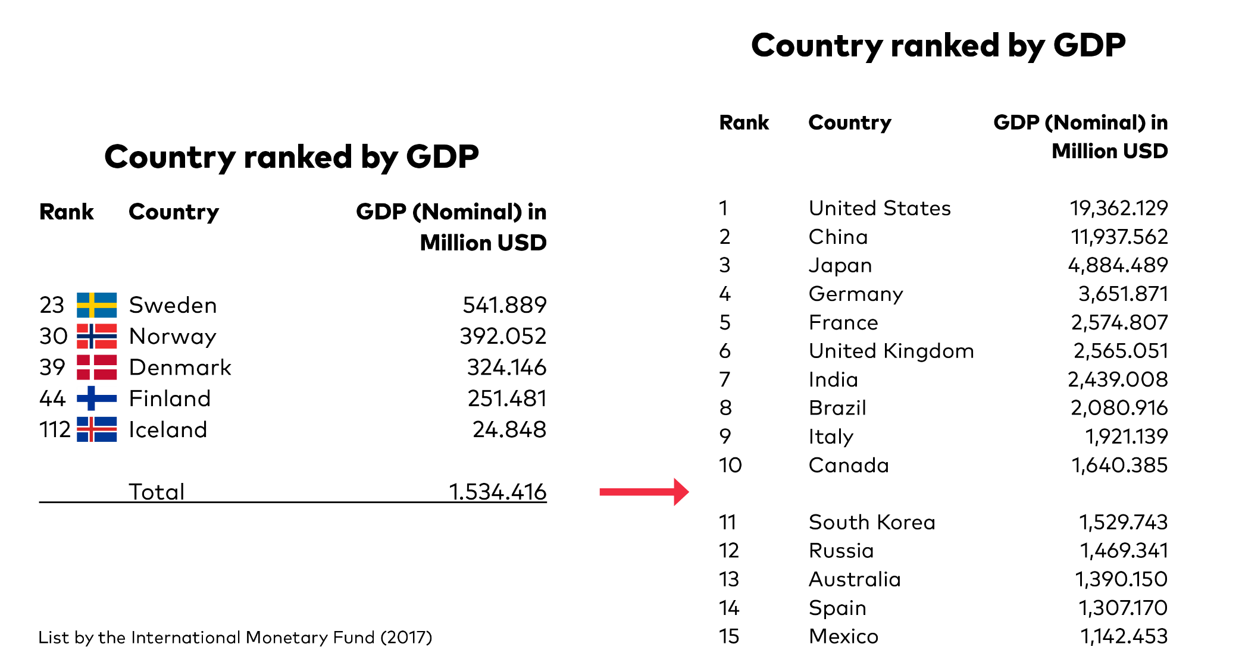
Combined we make up a large economy

Slide 4
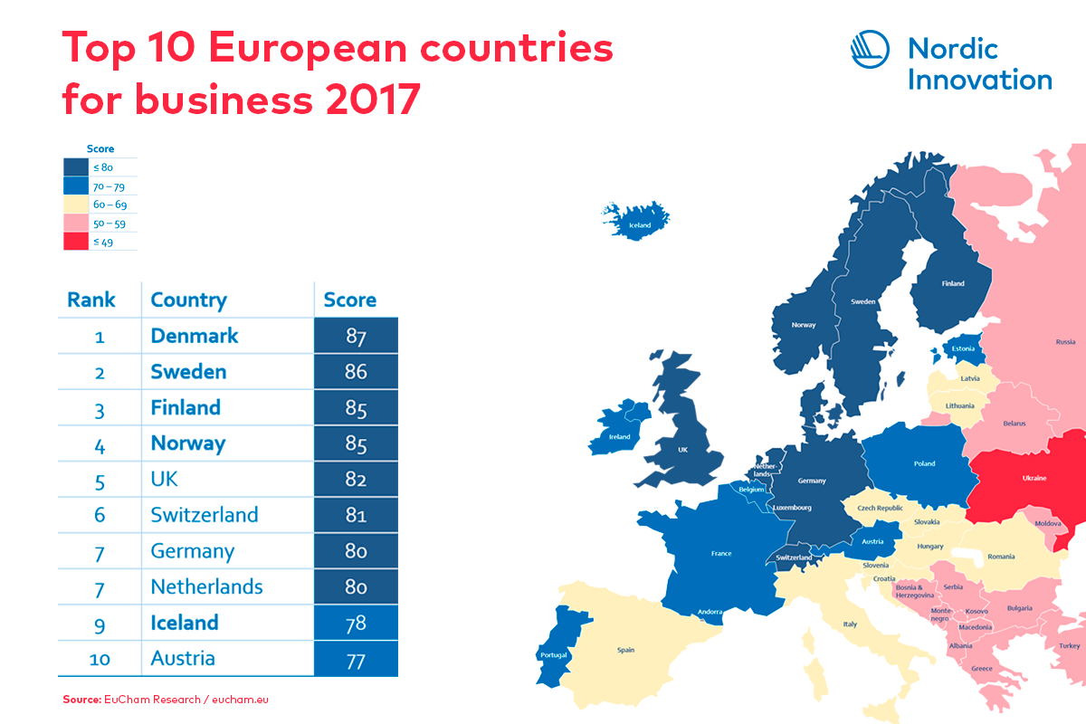

Slide 5
All of the Nordic countries score consistently well on global surveys intended to measure how innovative and innovation-friendly countries are.

Slide 6
Why Nordic
Nordic added Value – together we can more
We are seen as one region by others
Makes business sense; critical mass, costs, broader product portfolios
More attention and better access
Nordic is a strong brand
.
Economy of scale
Branding
Economy of scope

Slide 7
Our mission
To contribute to sustainable growth, increased entrepreneurship, innovation and competitiveness of Nordic businesses.

Slide 8
Nordic Innovation
Preserve our ability to adapt quickly to technological changes
Nordic cooperation to face technological change
Digitalisation and new green business models
Boost innovation and competitiveness
The public sector as a driver for innovation
Better access to risk capital across borders
Improve global market opportunities
The Nordic region as a global innovation hub
Cooperation on international markets
Notes:
Three goals – two strategies for each

Slide 10
How Nordic Innovation works
Nordic added value
Minimum 3 Nordic participants
Examples of instruments
Call for Proposals
Challenge Competition
Innovation Prizes
Nordic Big Missions
Nordic Networks (e.g. clusters)
Procurement

Slide 11
^{Health,} ^{Demography} ^{and} ^{Quality of Life} - We connect people, data and innovation for a better life
Thordur Reynisson

Slide 12
In 2030 the Nordics will be the most sustainable and integrated health region in the world, providing the best possible personalized health care for all its citizens.

Slide 13
Health, Demography & Quality of Life 2018-2021
Prevention
Healthy Cities
Value Chain Collaboration
Bridging Nordic Data Initiative

Slide 14
Activities 2019
Bridging Nordic Data Initiative
Scenario process
Visualization and interoperability
Nordic Health Hackathons
Mapping of legal obstacles and p0ssibilities
Prevention
Healthier Nordic Youth (to be initiated 2019/2020)

Slide 15
Activities 2019
Healthy Cities
Nordic Smart Cities: Innovating towards healthy and carbon-neutral living (2019 until 2021)
Value Chain Collaboration
Nordic collaboration towards defined export markets
Cross-sectoral collaboration of Nordic companies
Social Impact Investments

Slide 16
Ambition
Make the Nordic region a Hub for new innovative health solutions
The best environment for health companies and start-ups
Transform the Nordic health sector to become a role model for other countries
Marie Ullnert-Sahlgrenska

Slide 17
Thordur Reynisson
Senior Innovation Advisor
TR@nordicinnovation.org
Nordic Innovation
Stensberggata 27 -0170 Oslo - Norway
nordicinnovation.org

Slide 18
Thank you

